Slide 1

Principal’s Report
GO Team Meeting
September 8, 2022

Slide 2
TOPICS
School Start Update
Current Enrollment & Leveling
School Strategic Plan
Strategic Plan Overview
SMART Goals
GMAS Results

Slide 3
School start
UPDATE

Slide 4
2022-23 New School Initiatives
- Computer Science Pathway
- B.E.S.T. Boys Go Global
- MAP Assessment Score Increases
- Gettysburg Trip
“From Civil War to Civil Rights”
- New World Language – Swahili
- Two (2) New School Partners
- Ron Blue Trust
- Truist Bank
- All-Pro Dads Chapter
- MDI Partnership – Y.A.L.E. Academy
Notes:
Principals – please provide a general update as to how the school year is going

Slide 5
Enrollment
Projected Enrollment | 255
Current Enrollment | 246
Difference | -8
Leveling
Leveling is the process the District uses to adjust school budget allocations to match student enrollment.
Budget Impact | We experienced no leveling.
Notes:
Principals: Based on your enrollment, please give your GO Team the information on how you plan to account for any budget changes due to leveling.

Slide 6
2021-2025
Continuous
Improvement
Plan

Slide 7
BEST Academy
Goals
Our Overarching Needs
LITERACY Students need to consistently demonstrate an understanding of basic literacy skills, in order to increase achievement levels in all content areas. | NUMERACY Students need to demonstrate an understanding of basic math skills. | WHOLE CHILD & STUDENT SUPPORT To partner with identified stakeholders to provide Tier 2 and 3 resources and supports for identified students
SMART Goals (Elementary/Middle School)
The percentage of students in grades 6-12 scoring proficient or above in EOG ELA will increase by 5% in June 2023 | The percentage of students in grades 6-12 scoring proficient or above in EOG Math will increase by 5% in June 2023 | The percentage of students in grades 6-12 display a 5% decrease in the percentage of students in the elevated risk category on the BASC-3 Assessment from the first to the last administration
SMART Goals (High School)
The percentage of students in grades 6-12 scoring proficient or above in EOC American Lit-Comp will increase by 5% in June 2023 | The percentage of students in grades 6-12 scoring proficient or above in EOC Algebra I will increase by 5% in June 2023 | The percentage of students in grades 6-12 display a 5% decrease in the percentage of students in the elevated risk category on the BASC-3 Assessment from the first to the last administration
Progress Monitoring Measures
MAP ELA Growth Reports Read 180/System 44 Reports District Benchmark Data All-In-Learning Assessment Reports – Standards-Aligned Unit Assessments | MAP Math Growth Reports Math 180 Reports District Benchmark Data All-In-Learning Assessment Reports – Standards-Aligned Unit Assessments | Weekly meeting agendas for targeted grade level activities Bi-weekly BARR block meetings to review student data points Completion rate of schoolwide I-Time activities Monitoring of services provided by Chris 180.
Notes:
Notes for School CIP Teams: On this slide you will identify SMART goals for each priority area and how you will monitor progress towards those goals

Slide 8
Georgia Milestones Assessment Results

Slide 9
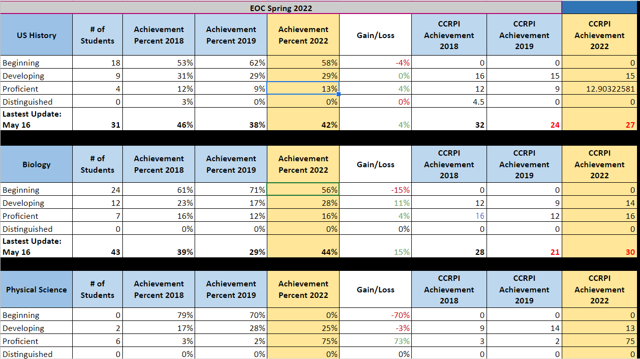
GMAS Results

Slide 10
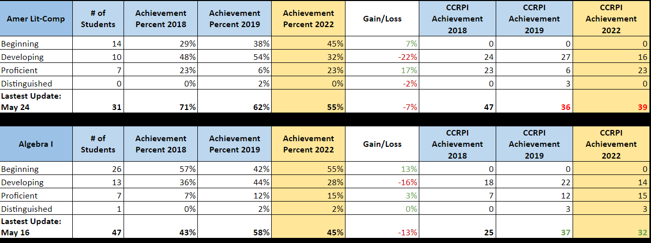
GMAS Results

Slide 11
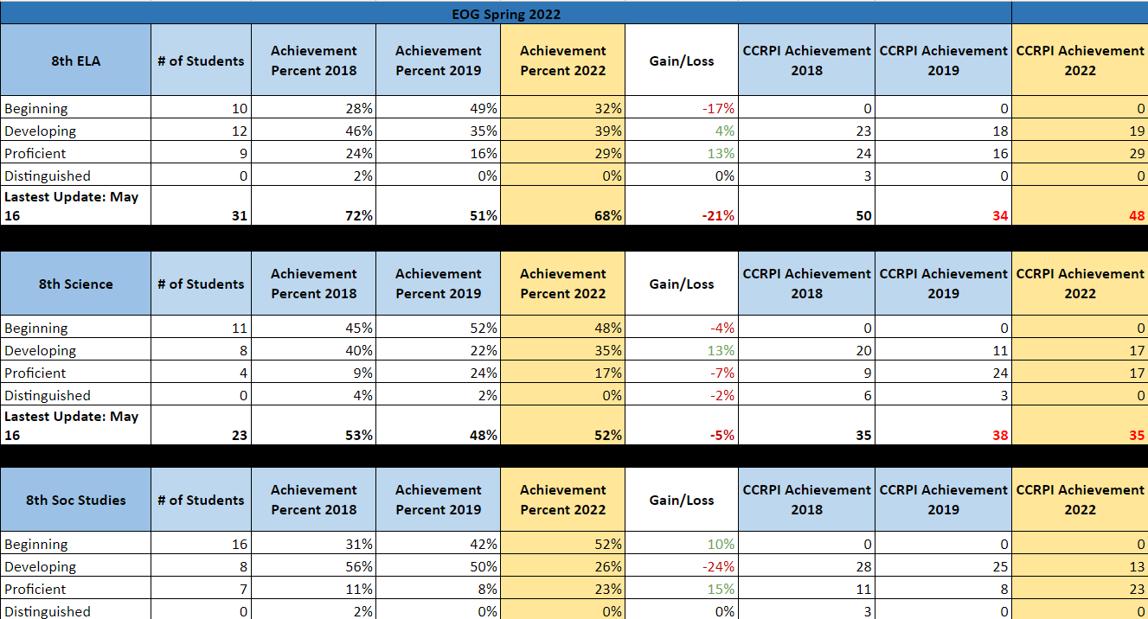
GMAS Results

Slide 12
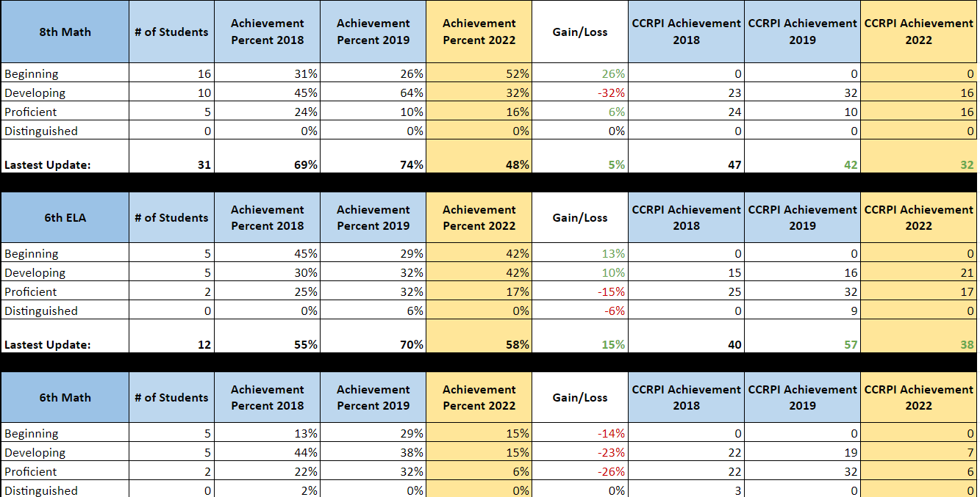
GMAS Results

Slide 13
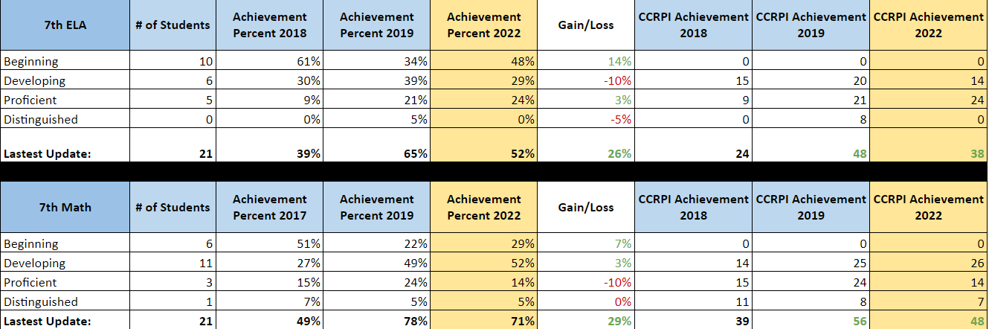
GMAS Results

Slide 14
Glows & Grows
Glows
Grows
Top performer in EOC American Lit (+14.7)
Top three performer in EOC Biology (+6.5)
75% Proficient in EOC Physical Science (+73)
Regression in EOG Math 8 (-6%)
Regression in EOC Algebra I (-3)
Modicum growth in EOG ELA (+0.4)

Slide 15
Questions?

